Slide 1
Motivation for Apache Spark

Slide 2
Spark Motviation
MapReduce greatly simplified big data analysis
But as soon as it got popular, users wanted more:
More complex, multi-stage applications (e.g. iterative graph algorithms and machine learning)
More interactive ad-hoc queries
Both multi-stage and interactive apps require faster data sharing across parallel jobs

Slide 3
Spark Motivation
As we saw in the PageRank example, MapReduce performs very poorly when the program contains multiple iterations
This is because the data needed to be stored on disk at the end of reduce and loaded again at the beginning of the next map.
There are also structures like the graph structure which never changes but we still had to read it at the beginning of every map.
Pregel solved this problem for graph problems
But what about other types of iterative problems which are not graph related?
For example most machine learning algorithms are iterative.

Slide 4
Spark is a General Framework
General framework that is low enough level that it can be used to replace all other frameworks.
MapReduce, Pregel, Storm, Hive, Pig, etc.
It’s main advantage is that it allows iterative programs to take advantage of data caching.
The data at the end of one iteration will be kept in RAM and passed directly to the next iteration without going to disk.
Performance improvement over MapReduce most noticeable for iterative programs.
Does a bunch of other cool things
Nice way of making fault tolerance really cheap
Minimizes communication with some cool tricks

Slide 5
Throw out the rest
Spark can do everything the rest can do but do it better!
Spark has a MapReduce API which allows you to directly run MapReduce at up to 100 times performance improvement
Includes a graph API called GraphX which implements the Pregel API in 20 lines of code.
SparkSQL includes the Hive API and is up to 100 times faster than Hive on MapReduce
There is a streaming API on top of Spark that is 2 to 5 times faster than Storm.
It has a nicer high level API than Pig and is faster than Pig
Spark is very popular and will likely replace most Hadoop MapReduce deployments in the near future.

Slide 6
Spark’s Approach
Instead of specializing, generalize MapReduce to support new apps in same engine
Two changes (general task DAG & data caching) are enough to express all previous models!

Slide 7

Spark
Unifies batch, streaming, interactive comp.
Easy to build sophisticated applications
Support iterative, graph-parallel algorithms
Powerful APIs in Scala, Python, Java
Batch, Interactive
Data-parallel,
Iterative
Streaming
Sophisticated algos.
Spark
Streaming
SparkSQL
GraphX
MLlib
Spark
Batch, Interactive

Slide 8
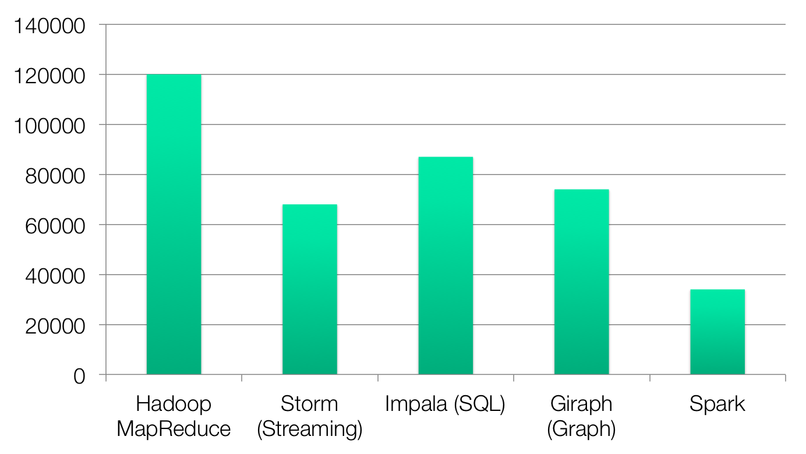
Code Size
non-test, non-example source lines

Slide 9
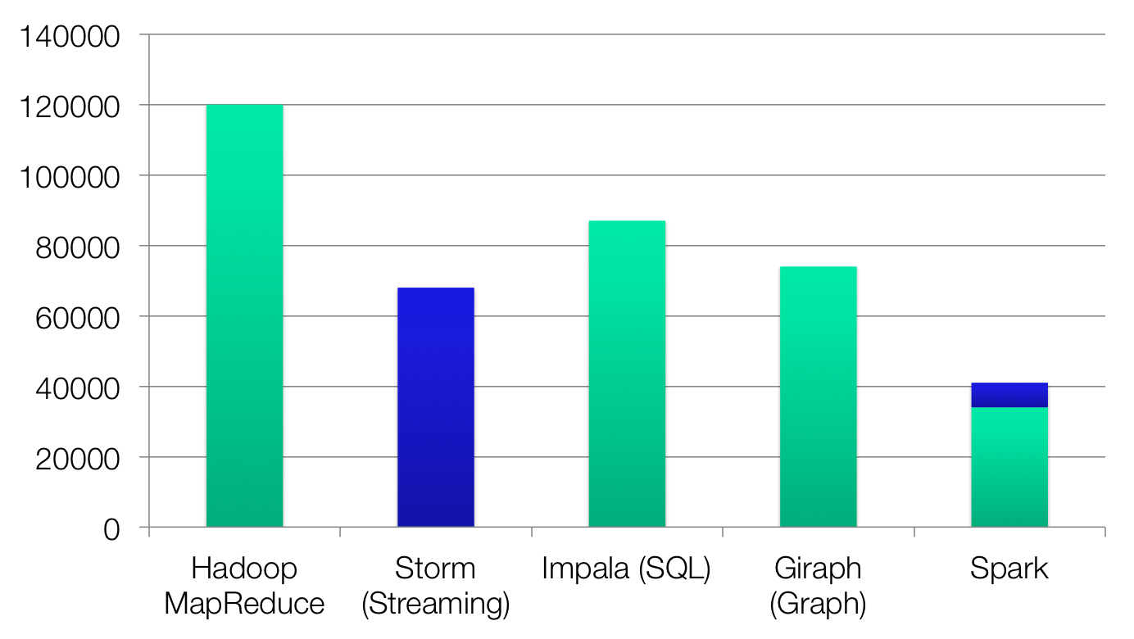
Code Size
Streaming
non-test, non-example source lines

Slide 10
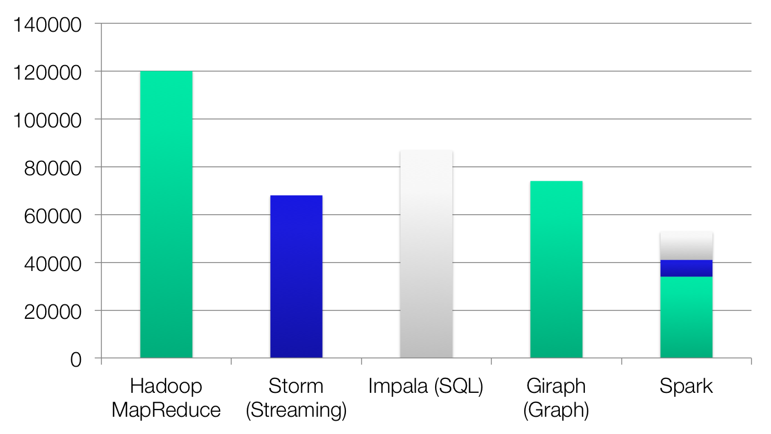
Code Size
SharkSQL
Streaming
non-test, non-example source lines

Slide 11
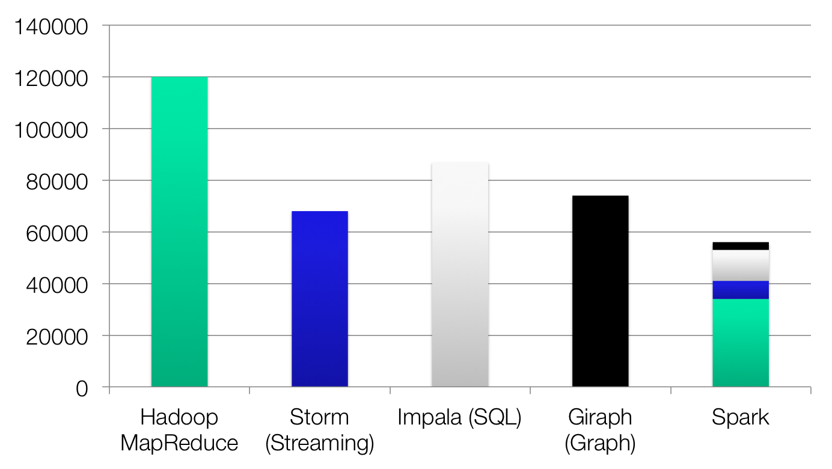
Code Size
GraphX
SparkSQL
Streaming
non-test, non-example source lines

Slide 12
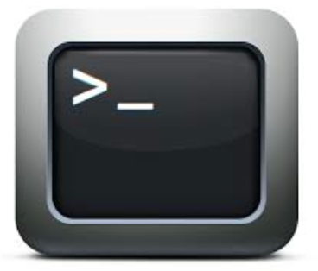


What it Means for Users
Separate frameworks:
HDFS read
ETL
HDFS write
HDFS read
train
HDFS write
HDFS read
query
HDFS write
…
Spark:
Interactive analysis
HDFS read
ETL
train
query
HDFS

Slide 13
Combining Processing Types
From Scala:
val points = sc.runSql[Double, Double]( “select latitude, longitude from historic_tweets”) val model = KMeans.train(points, 10) sc.twitterStream(...) .map(t => (model.closestCenter(t.location), 1)) .reduceByWindow(“5s”, _ + _)
The above example first runs a SQL query to project just two columns from a file containing historical twitter tweets
It then applies the machine learning algorithm KMeans clustering to find 10 cluster centers
Finally it treats the historical tweets as a data stream and then maps each point to the closest cluster center for windows of 5 second duration.

Slide 14

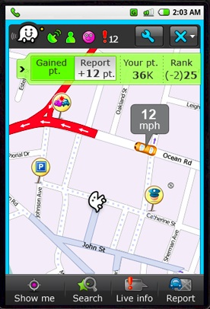
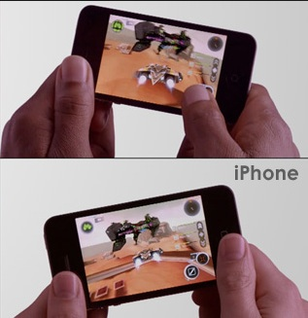
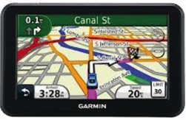
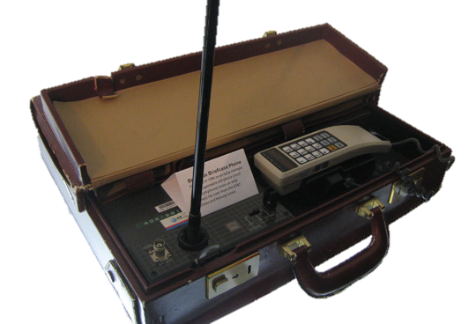


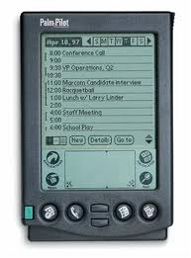



An Analogy
Better Phone
Better Games
z
Better GPS
First cellular
phones
Specialized
devices
Unified device
(smartphone)
Notes:
To illustrate the case for unification, consider the following analogy: the evolution of mobile devices.
First mobile phones enabled something new (phone calls anywhere), but were far behind the potential of the technology.
The next stage saw an explosion of specialized mobile devices: mobile phones, PDAs, GPS devices, MP3 players, handheld video games, video cameras.
The last stage has seen the apparition of iPhone, the first smartphone, which unifies the functionalities of all these devices. And what is great about an smartphone is not that it is a better camera than a proper camera or a better GPS than a proper GPs, but that it enables new applications, better than any of these devices can provide in isolation. Leverage crowd sourcing map applications, like waze, mubile multi-player games, appliactions like instagram where users can immediately share their pictures, and many more!

Slide 15






An Analogy
Batch processing
Specialized
systems
Unified system
Notes:
A similar evolution is taking place in the big data space.
Hadoop provided a new capability, …
Soon people needed more than batch processing, and they started building a plethora of specialized frameworks, storm for streaming, graphlab for graph computation, and so on.
We believe the logical next step in the evolution is Spark that unifies the functionalities of many of the previously he same way the smartphone has unified the functionality of many mobile devices. And like smarthpone, we believe that this unification will enable developers to write new applications which are fundamentally better than what they can do today.

Slide 16
Turning Data into Value, Examples
Unify real-time and historical data analysis
Easier to build and maintain
Cheaper to operate
Easier to get insights, faster decisions
Unify streaming and machine-learning
Faster diagnosis, decisions (e.g., better ad targeting)
Unify graph processing and Extract Transform and Load (ETL)
Faster to get social network insights (e.g., improve user experience)
Notes:
Next, let me give three examples showing how unification can enable new applications or improve existing ones.

Slide 17
Graph Processing and ETL
Imagine you are trying to do some graph analytics on Wikipedia data.
You need to a lot of ETL in order to get the data in the right format to be put into a graph engine
ETL: extract transform and load
In traditional Hadoop you need to create workflows like
Use MapReduce to do ETL
Run graph engine on the output of the MapReduce
In spark you can do everything together in the same script within minutes.

Slide 18







Spark Users

Slide 19














Popularity of Apache Spark
More than 3000 companies using Apache Spark
Spark had more than 1000 contributors in 2015
one of the most active projects in the Apache Software Foundation
Notes:
Alibab, tenzent
At Berkeley, we have been working on a solution since 2009. This solution consists of a software stack for data analytics, called the Berkeley Data Analytics Stack. The centerpiece of this stack is Spark.
Spark has seen significant adoption with hundreds of companies using it, out of which around sixteen companies have contributed back the code. In addition, Spark has been deployed on clusters that exceed 1,000 nodes.

Slide 20
Project History
Spark built by the students of the Berkely AMP Lab
Spark project started in 2009, open sourced 2010
Shark started summer 2011, alpha April 2012
In use at Berkeley, Princeton, Klout, Foursquare, Conviva, Quantifind, Yahoo! Research & others
In 2013, the project was donated to the Apache Software Foundation and switched its license to Apache 2.0.
In February 2014, Spark became a Top-Level Apache Project
In June 2015
IBM announced it would put 3500 IBM researchers and developers to work on Spark-related projects
IBM will educate more than 1 million data scientists and data engineers on Spark

Slide 21
References for More Detail
Due to time constraints I can only only give a relatively brief description of spark.
To write high performing spark code you should know more
Watch these videos
Spark Programming
http://www.youtube.com/watch?v=7k4yDKBYOcw
http://www.youtube.com/watch?v=w0Tisli7zn4
Shark
http://www.youtube.com/watch?v=qSQDpSSafmg
Spark streaming
http://www.youtube.com/watch?v=g171ndOHgJ0
Understanding performance bottlenecks in spark
http://www.youtube.com/watch?v=NXp3oJHNM7E
Scala
http://www.youtube.com/watch?v=_qRYOayG9SM

